Slide 1
Precise Onset Cell Phone Vibration Detection
Lightning Presentation
National Center for Adaptive Neurotechnologies
(NCAN)
Md. Sadman Kabir, Muhammed Shuaib, Nasser AL-Maskari,
Daniel Brown
Date: 11/21/2023

Slide 2

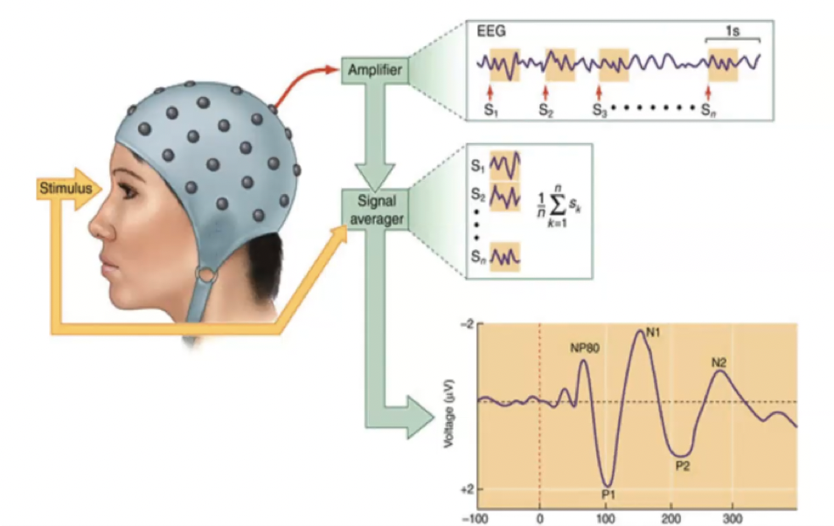
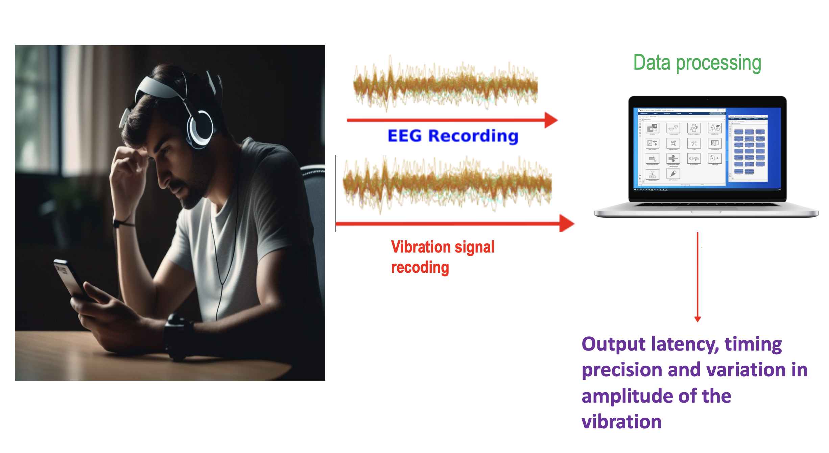
Introduction
Brain and spinal cord injury lead to sensory deficits such as loss of sense of touch. There are limited methods to test progress in rehab.
There is a need for a portable device for precise detection of stimulus onset on a large group.

Slide 3
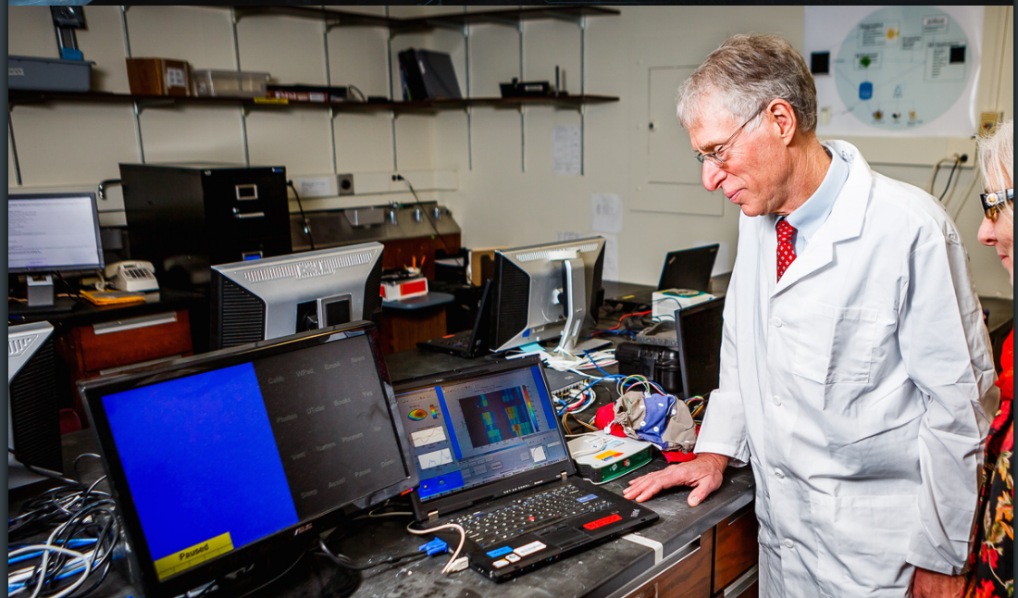
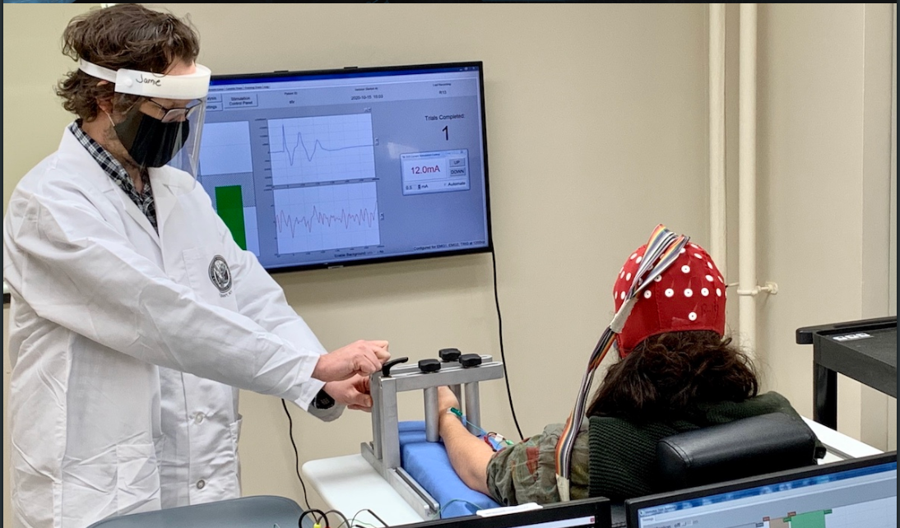
Background and Context
NCAN's senior scientists, Dr. Hill and Dr. Gupta, require us to build a high-precision, low-latency, affordable device for detecting Vibration Onset with 5ms accuracy

Slide 4
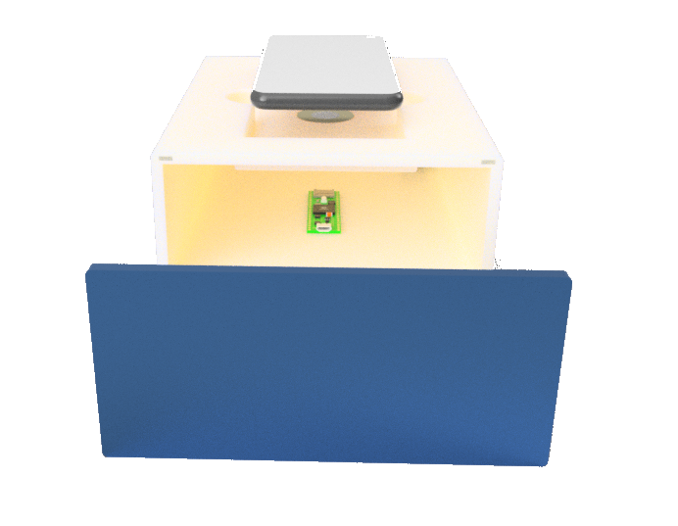
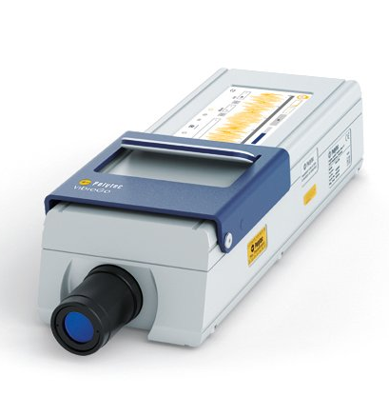
Goals for the Fall & Spring Semester
Current Semester Progress:
3D Modeling of Sensor Subsystem.
Testing vibration detection sensors
Implementing signal acquisition libraries
and BCI2000 on Teensy Microcontroller.
What’s next
Transitioning from a Piezo Sensor to a
Contactless Solution.
Investigate the role that Finger pressure has on the piezo
Solutions Signal.

Slide 5
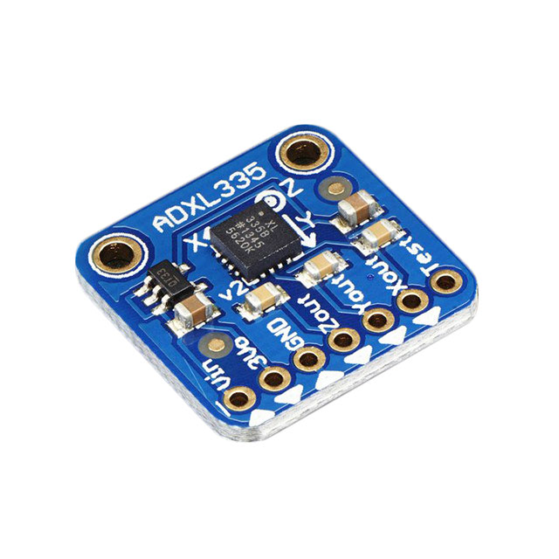
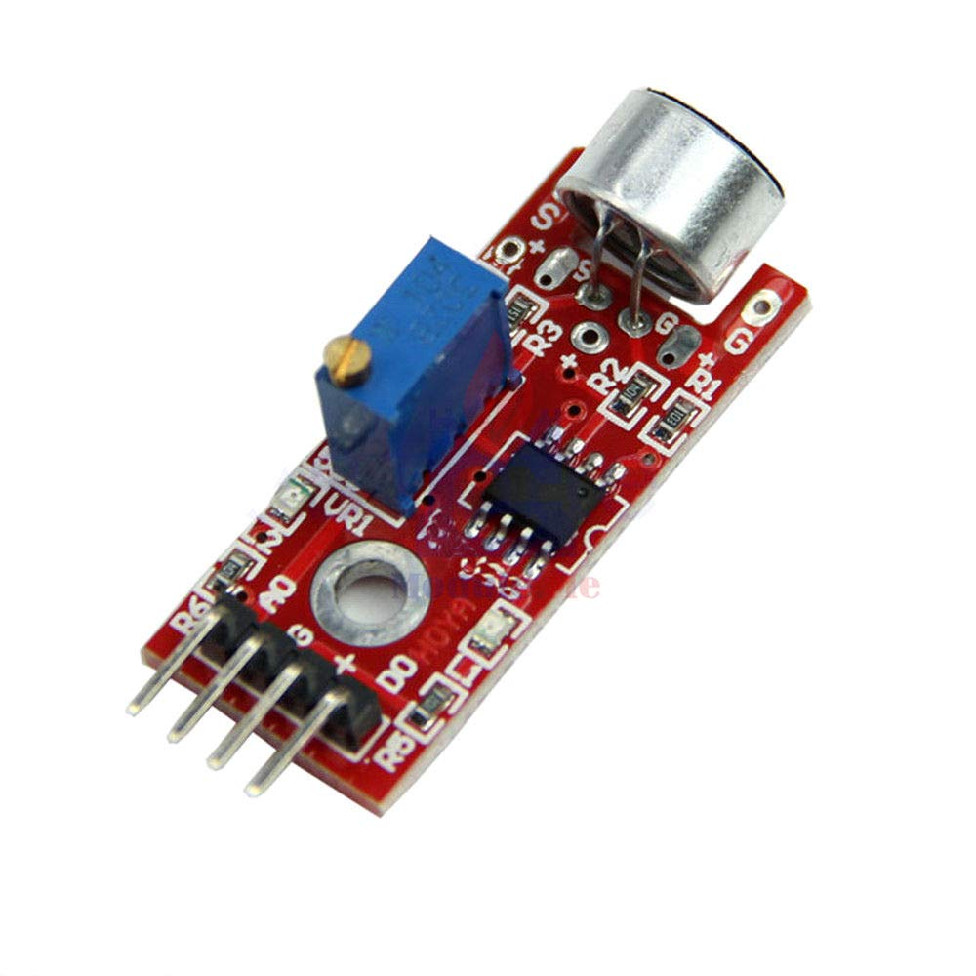
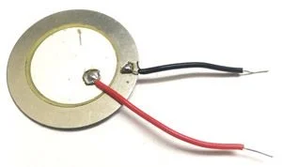
Design prototypes
Piezo electric sensor
Accelerometer
Microphone sound sensor

Slide 6
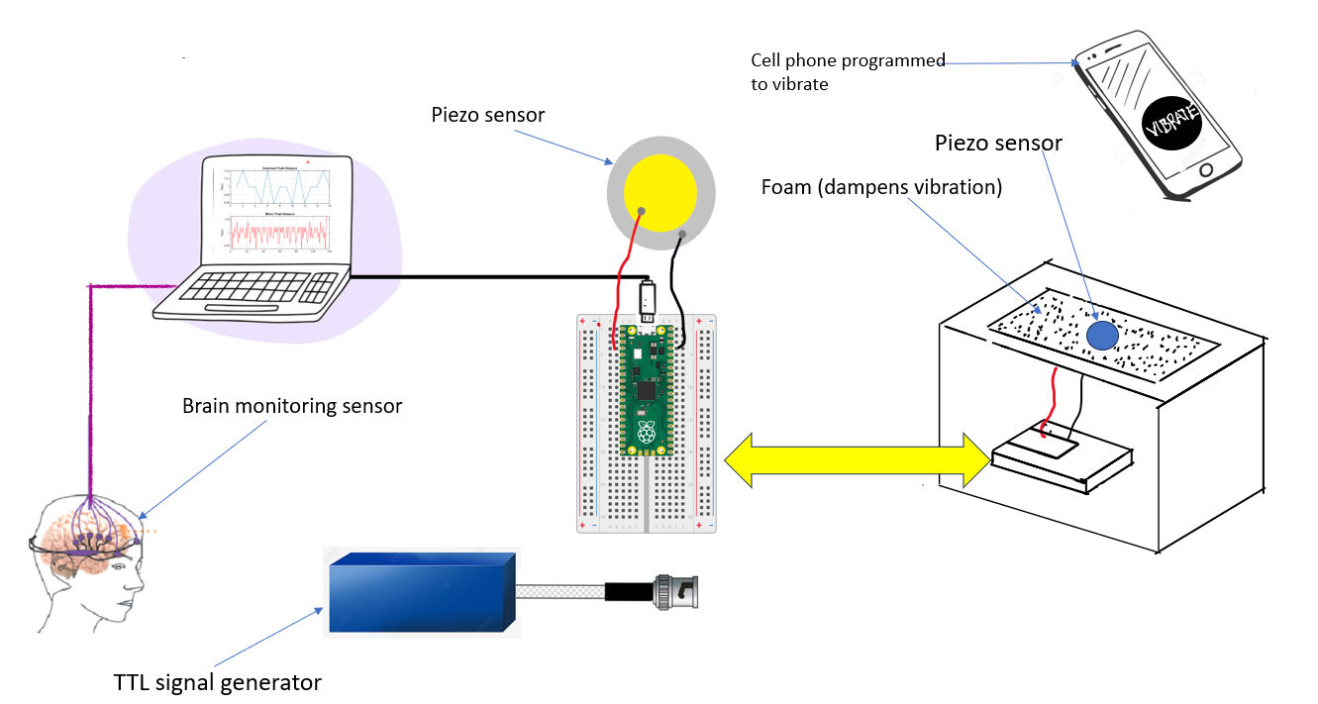
Design

Slide 7
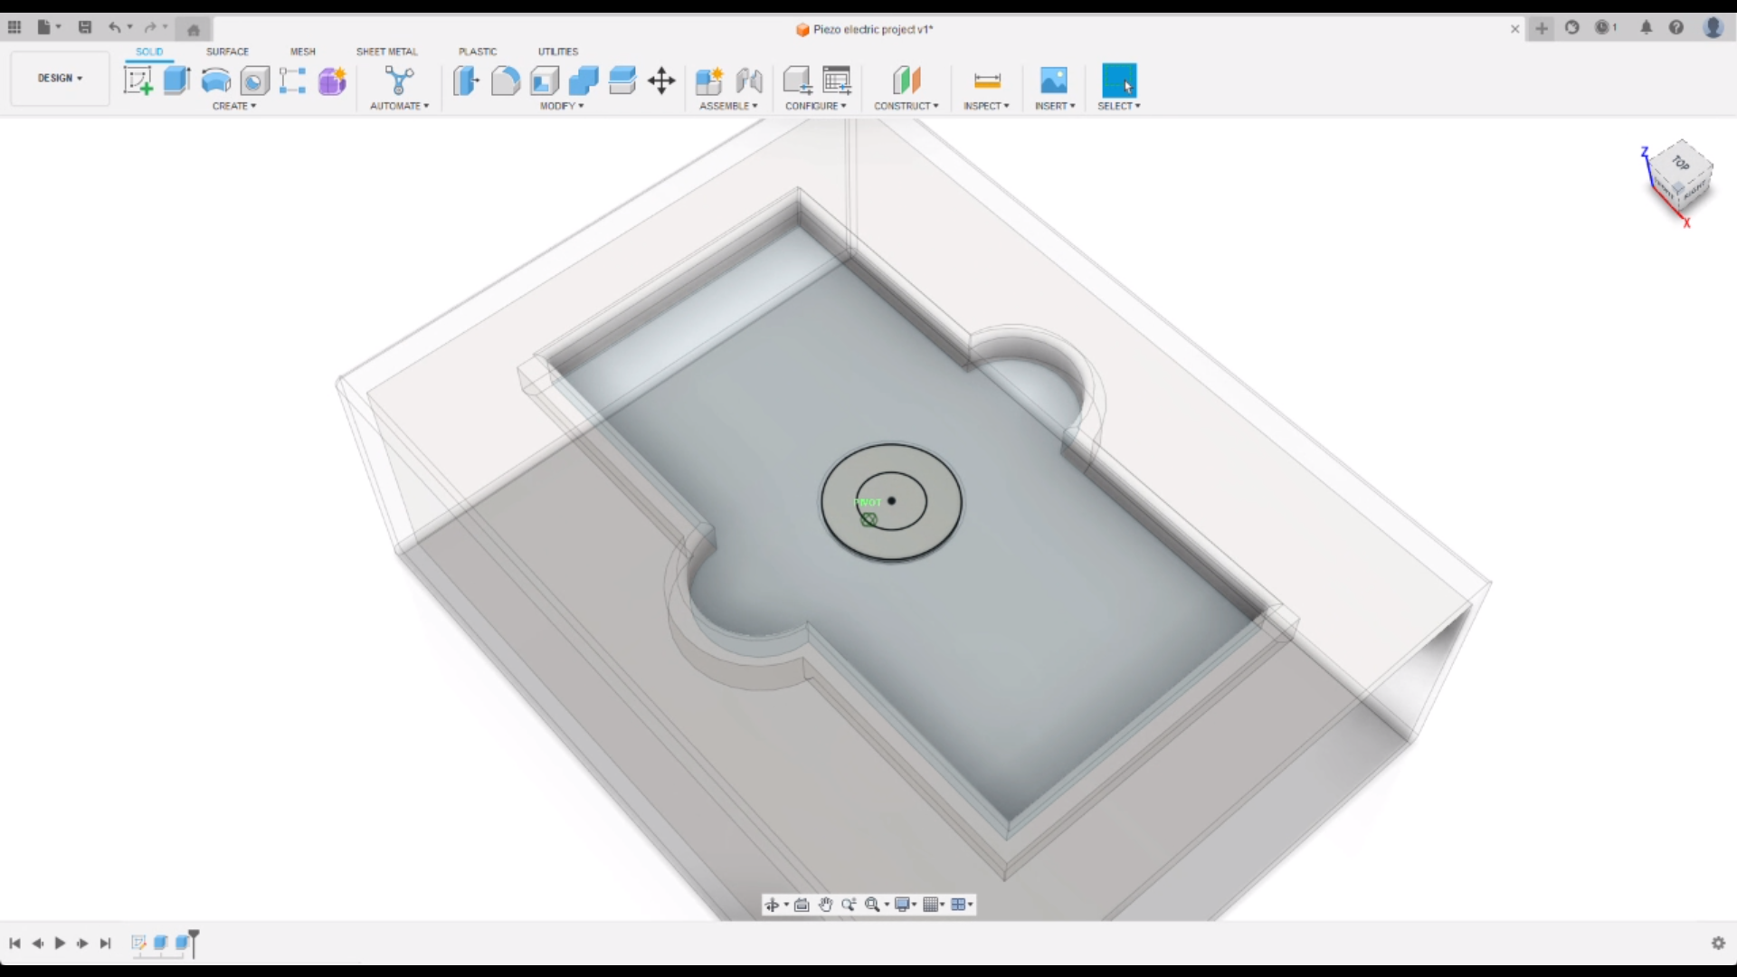
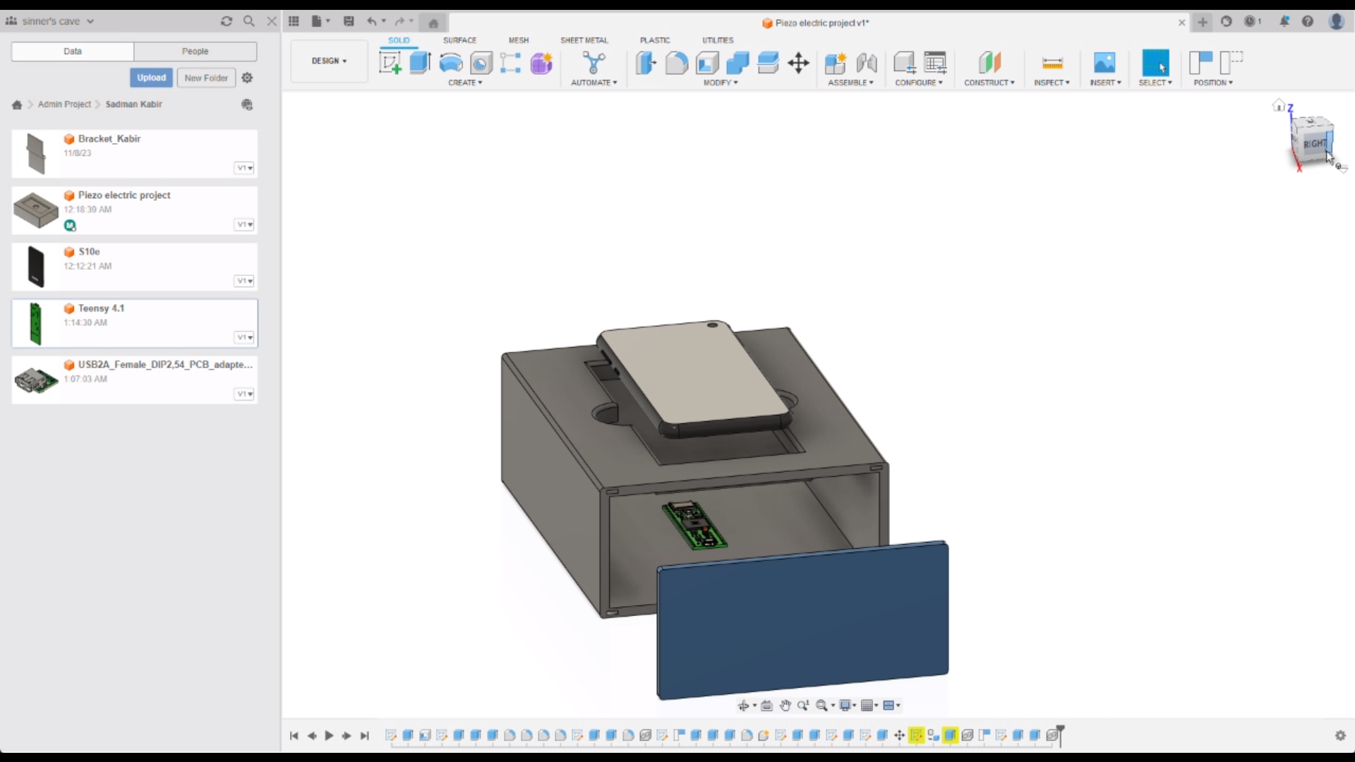
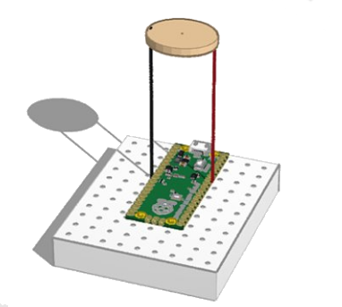
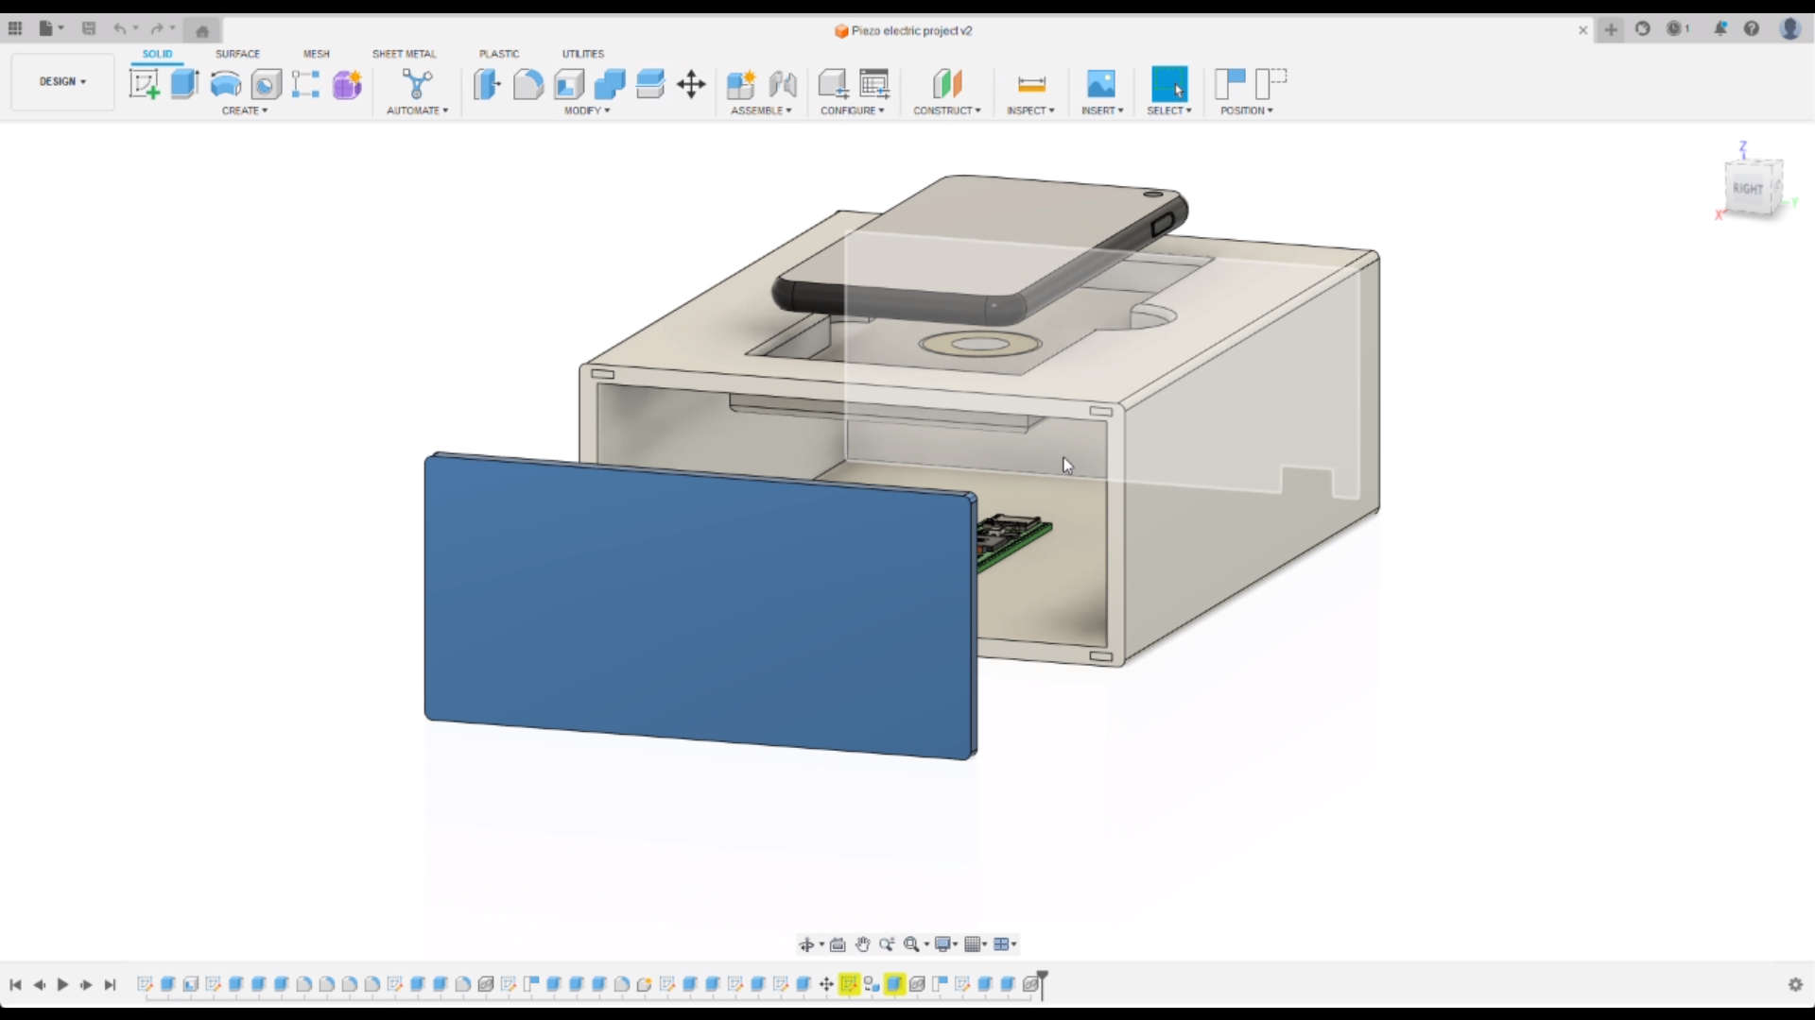
System Demonstration

Slide 8
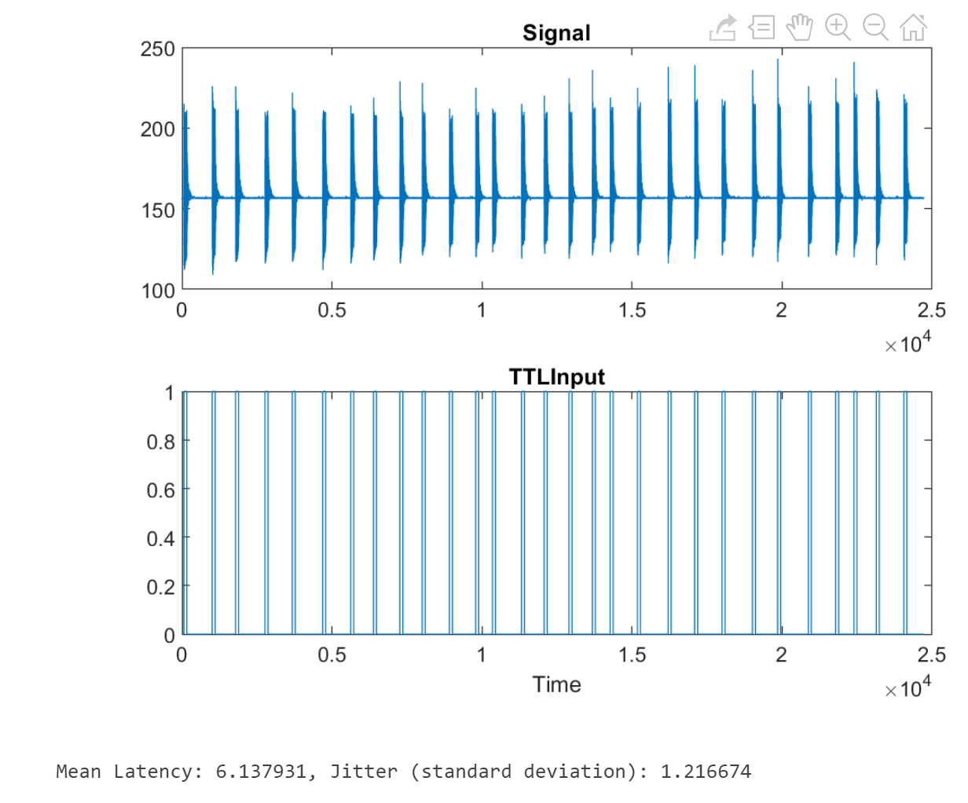
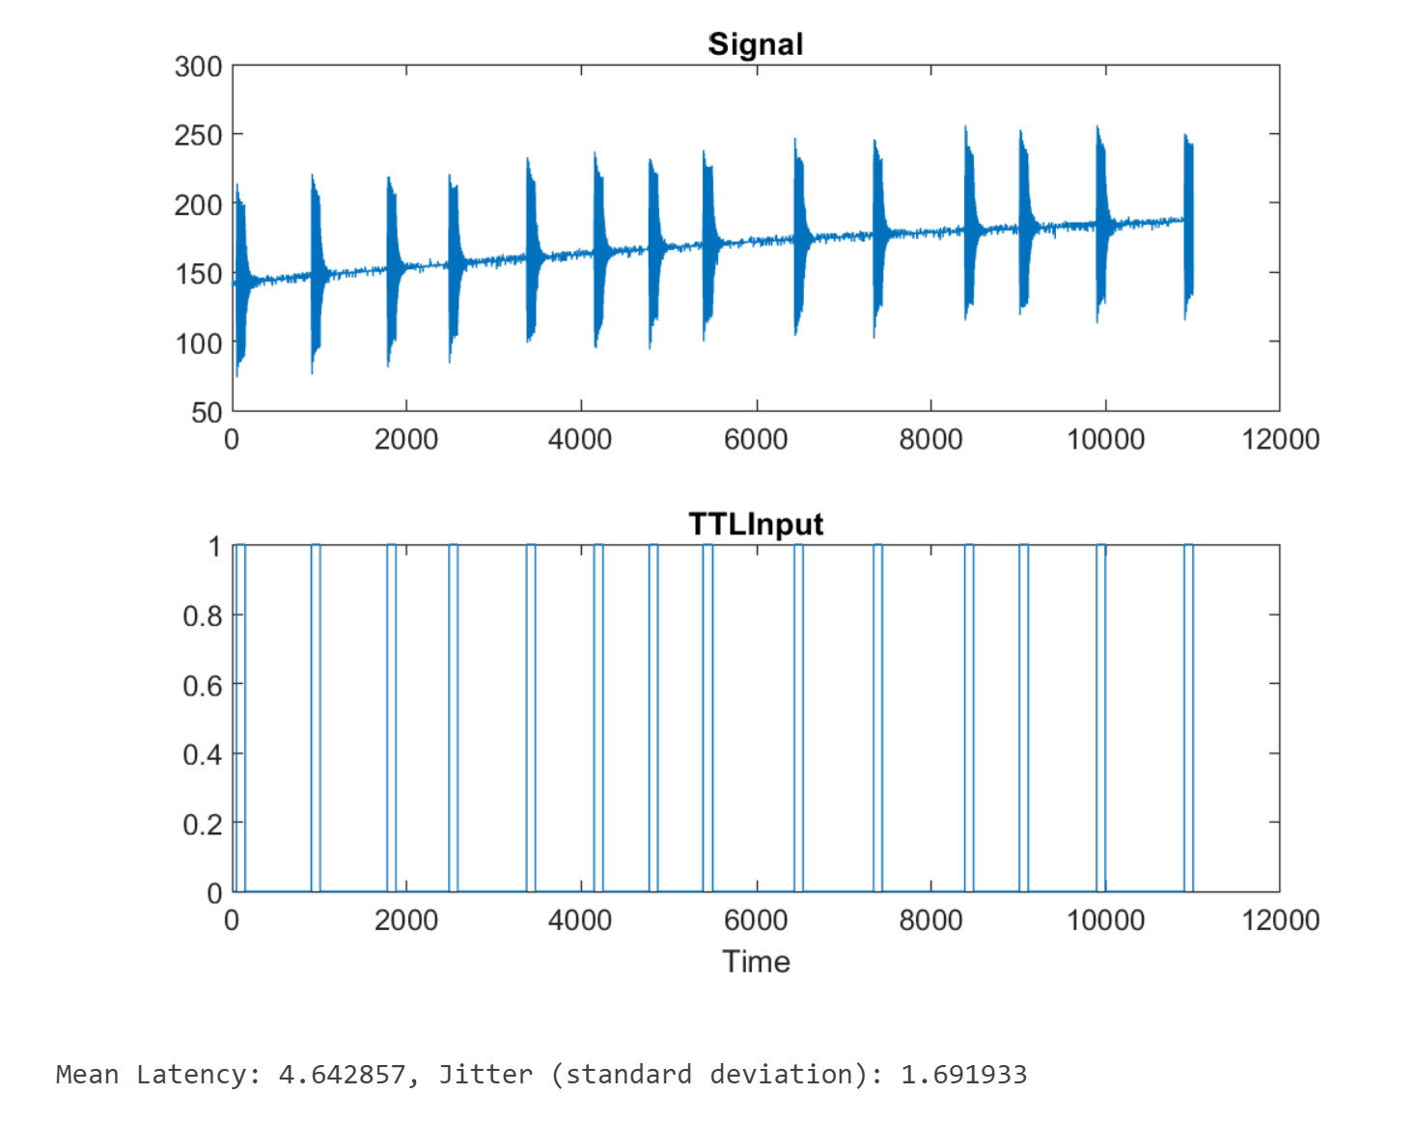
Data and Results
Sensor Down
Sensor Taped
Latency: 6.138 Jitter: 1.2166
Latency: 4.648 Jitter: 1.6919

